Slide 1


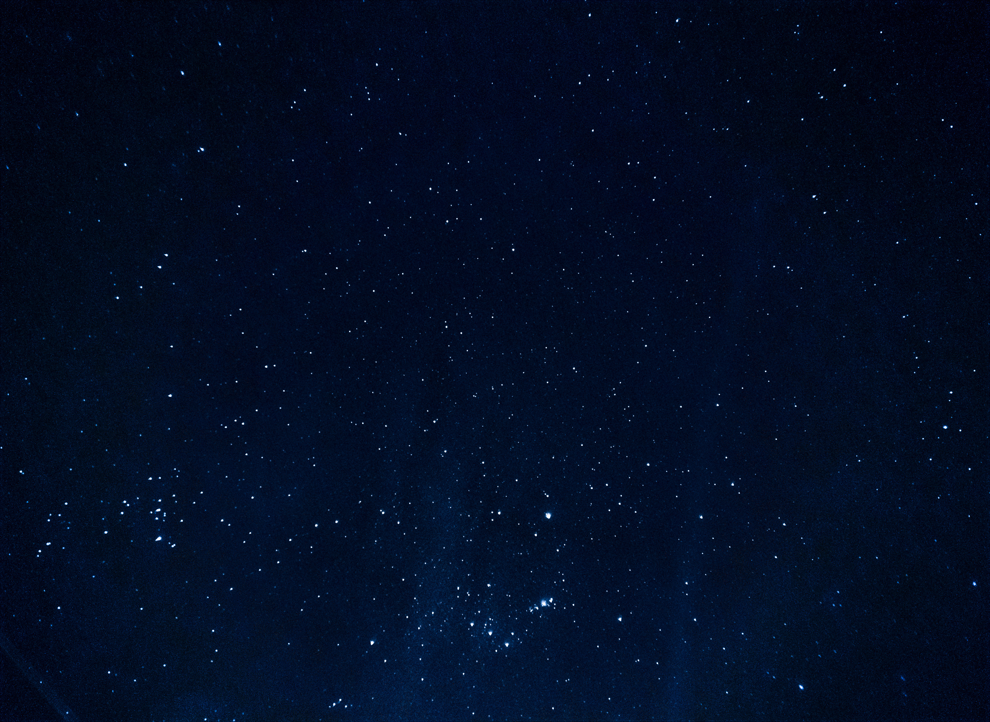
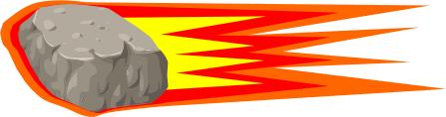

METEOR MADNESS
TEAM MEMBERS:
THIS IS OUR VERY FIRST TIME PARTICIPATING IN THIS CHALLENGE, AND WE’RE EXCITED TO DIVE IN AND GIVE IT OUR BEST. WE LOOK FORWARD TO EXPANDING OUR KNOWLEDGE IN BOTH ASTRONOMY AND CODING THROUGH THIS PROGRAM, WHILE ALSO LEARNING FROM NEW EXPERIENCES AND CHALLENGES ALONG THE WAY.
Khaydarova Dilbar
Shavkatbekov Ibrohim
Khoshimjonov Bobur
Rakhimjonova Iroda
Muhammadjanov Dovud
Abdukomilov Husan
Team: LocalToGlobal

Slide 2
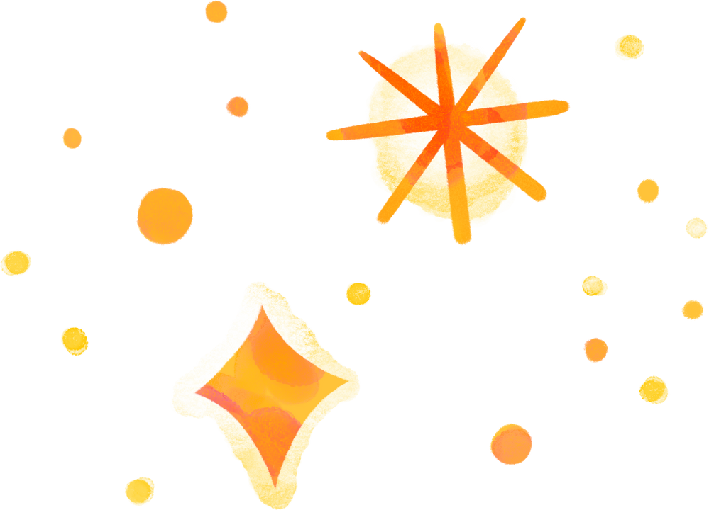
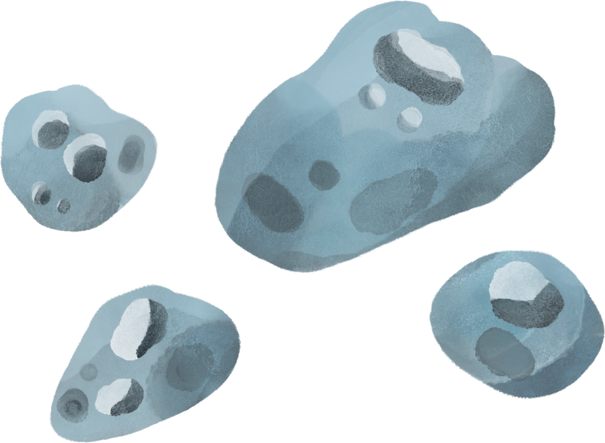
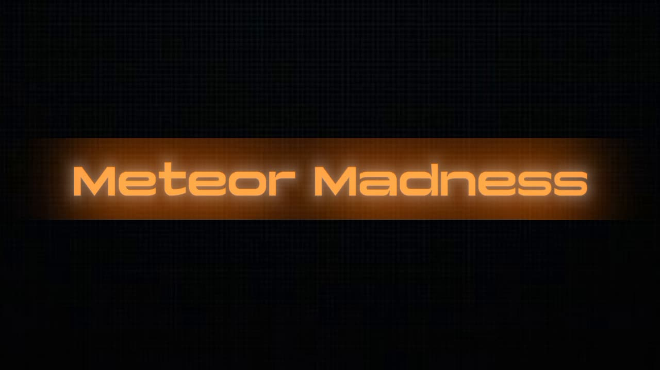
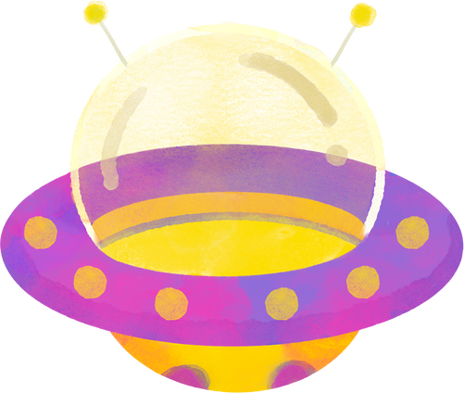
IMAGINE THIS:
“You’re sitting at home, scrolling on your phone… when suddenly, the sky lights up brighter than the sun. A rock the size of a house is racing toward Earth—faster than a bullet. What would you do? Could we stop it?”
“This isn’t just science fiction. It’s the reality behind

Slide 3
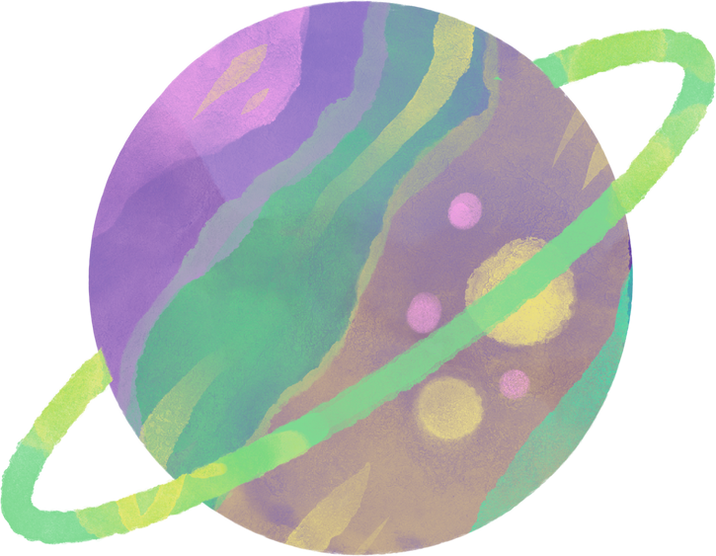
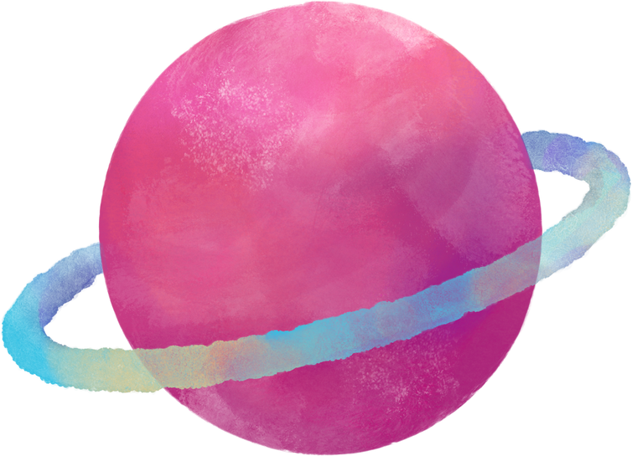
WHY METEOR MADNESS?
We chose Meteor Madness because even the smallest object from space can cause massive destruction. History shows us this — for example, the dinosaurs disappeared because of a single meteor impact, which was 10 km wide. Every day, Earth is protected as small meteors burn up in the atmosphere — most of the time we don’t even notice it.
But what if one day a bigger one comes, and Earth can’t protect us? The result could be devastating for all of humanity.
That’s why we chose this topic: to explore how we can use NASA’s data to understand meteors, prepare for them, and protect our planet

Slide 4

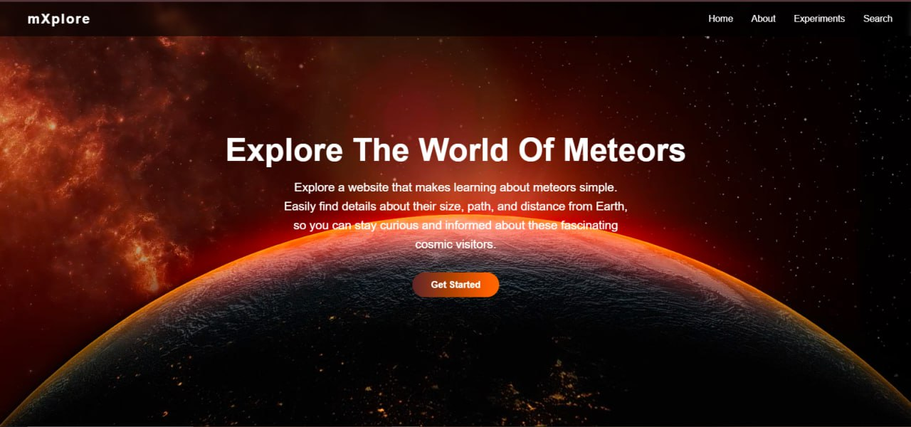

WE CREATED
mXplore!
We chose the Meteor madness theme for the NASA Space Apps Challenge and developed the mXplore website

Slide 5


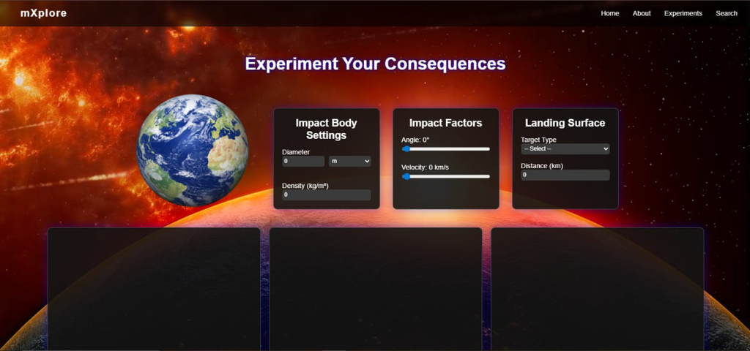

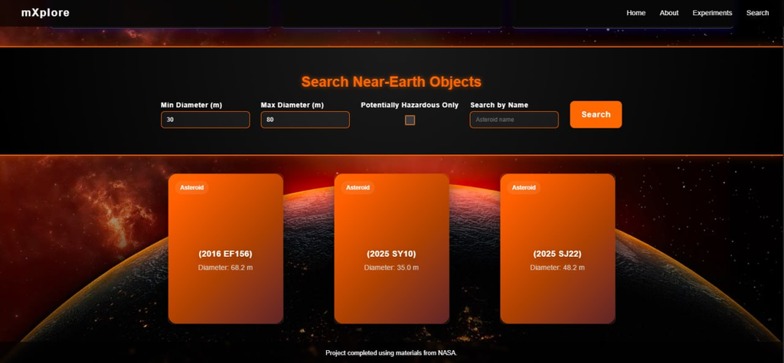
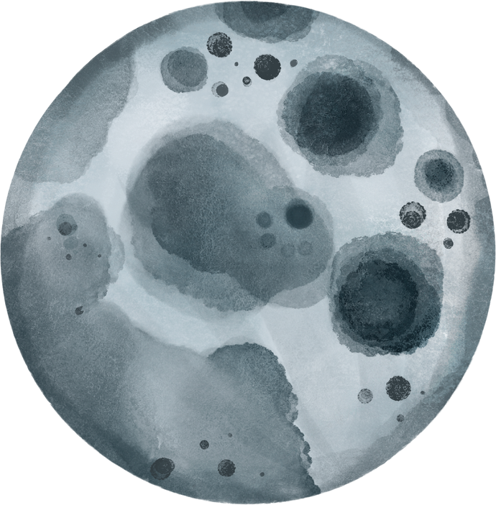
SOLUTION
This page shows how an asteroid can affect the Earth.
It provides information about the asteroid — for example, what material it’s made of, and whether it can destroy the ozone layer or not.
The Search Near-Earth Objects page connects to NASA’s API to retrieve real-time asteroid data. Users can search for asteroids by size range, name, or hazard status. The results display key details such as each asteroid’s name and diameter, making it easier to analyze potential near-Earth threats.

Slide 6
KEY STRENGTHS OF MXPLORE
Educational & Interactive: Helps users learn about asteroids and their effects on Earth through experiments.
Uses Real NASA Data: Connected to NASA’s API for accurate and updated information.
Raises Awareness: Shows how asteroid impacts can affect Earth’s atmosphere and ozone layer.
Visual & Engaging: Simulates real asteroid impacts to make science more exciting.
Smart Search System: Lets users find asteroids by size, name, or hazard level.
Inspires Curiosity: Encourages interest in astronomy, coding, and space research.

Slide 7

OUR FUTURE PLANS:
In the future, we plan to expand mXplore by adding educational games for kids, integrating new APIs and an AI chatbot for asteroid information, and creating a 3D simulation of meteor and Earth collisions.

